Slide 1
Siemens STEP7
Programs and Reusable Data Blocks
© 2013 John Sefcovic and Oakland Community College.

Slide 2



Block Structures
The PLC program use a Function Block which is “reused” by different Data Blocks containing process variables.

Slide 3
Function Block and Data Blocks
In this example, Glue Function Block is called twice in the program. The Function Block uses different Data Blocks for each call from the Organization Block.
Glue Function Block_DB1
Glue Function Block
Main
Glue Function Block_DB2

Slide 4
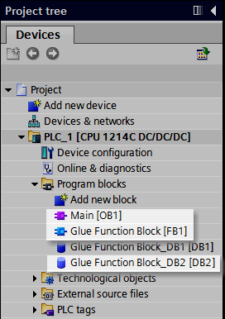

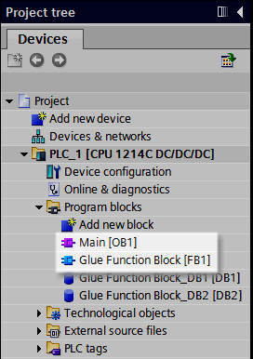
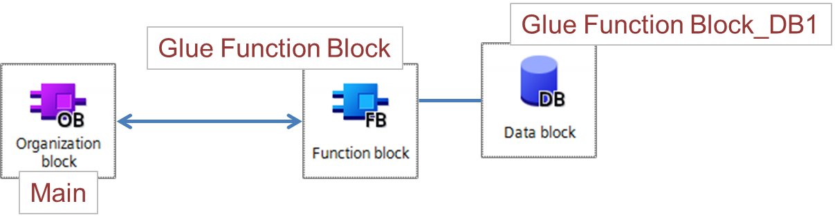
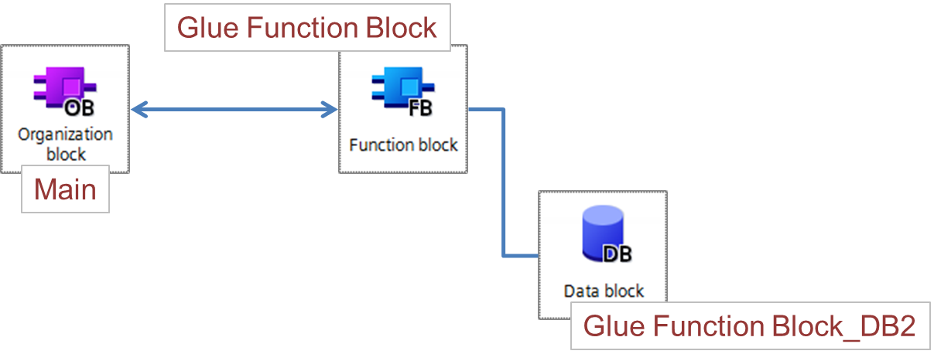
Function Block and Data Blocks
When the program in the Organization Block Main [OB1] calls the Function Block Glue Function Block [FB1], the Data Block Glue Function Block_DB1 [DB1] for Glue 1 type is used for the process values.
When the program in the Organization Block Main [OB1] calls the Function Block Glue Function Block [FB1], the Data Block Glue Function Block_DB2 [DB2] for Glue 2 type is used for the process values.
The Project tree showing the:
Organization Block Main [OB1]
Function Block Glue Function Block [FB1]

Slide 5
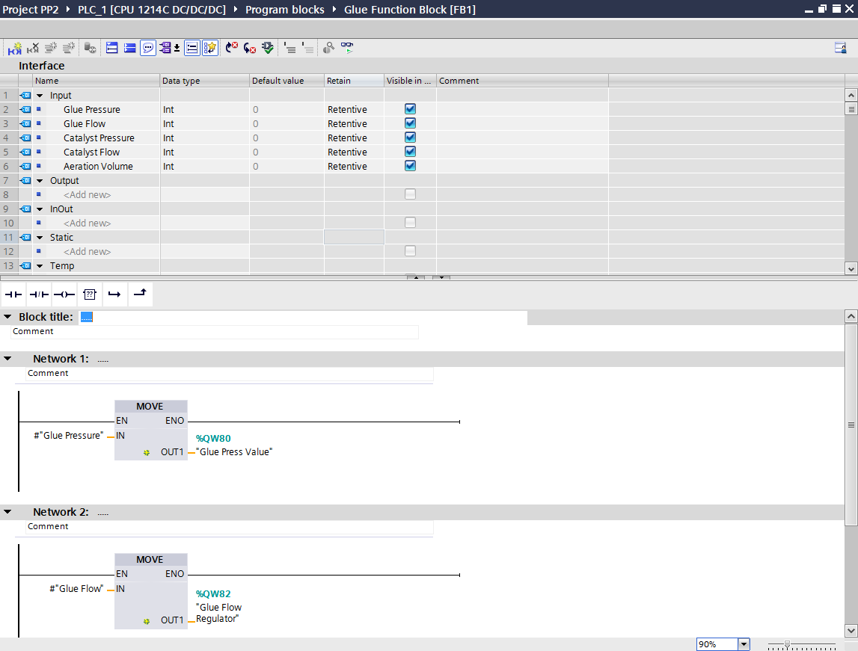
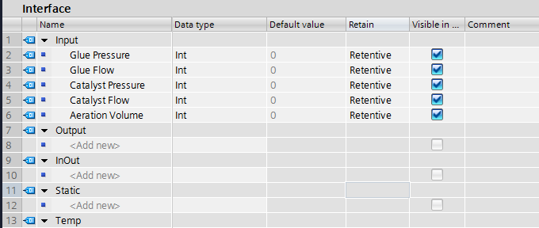
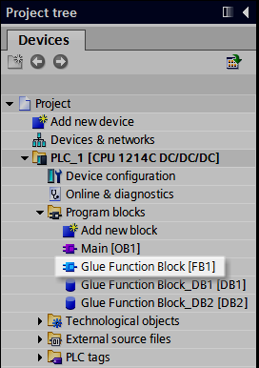
Function Block and Data Blocks
Function Block Glue
Function Block [FB1]
Function Block and Interface Instances.
The Input Instances to the Function Block.
When the Function Block is called in the Organization program, these Input Instances will be use the values from the Data Block associated with the call.

Slide 6
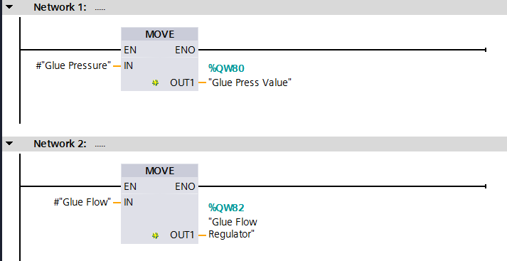
Function Block and Data Blocks
The Instances in the Function Block Interface are used in the program’s Network logic.
The instruction uses the value to control the PLC’s output for the glue guns pressure.
The Glue Pressure Instance will get its value from the associated Data Block.
The Glue Flow Instance will get its value from the associated Data Block.
The instruction uses the value to control the PLC’s output for the glue guns flow rate.

Slide 7
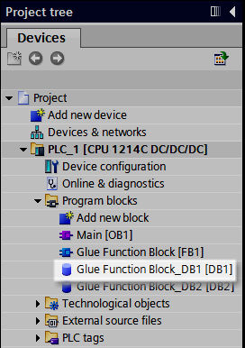
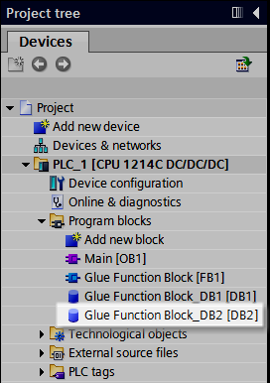
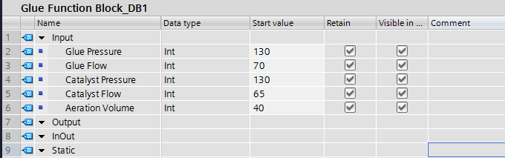

Function Block and Data Blocks
Data Block Glue Function Block_DB1 [DB1] hold the values for the glue dispenser for Glue 1 type.
Data Block Glue Function Block_DB1 [DB2] hold the values for the glue dispenser for Glue 2 type.
The values in Data Block [DB1] is associated with the Function Block Instances when called in the Main [OB1] program.
The values in Data Block [DB2] is associated with the Function Block Instances when called in the Main [OB1] program.

Slide 8
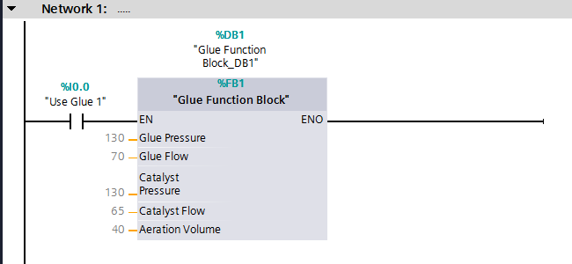
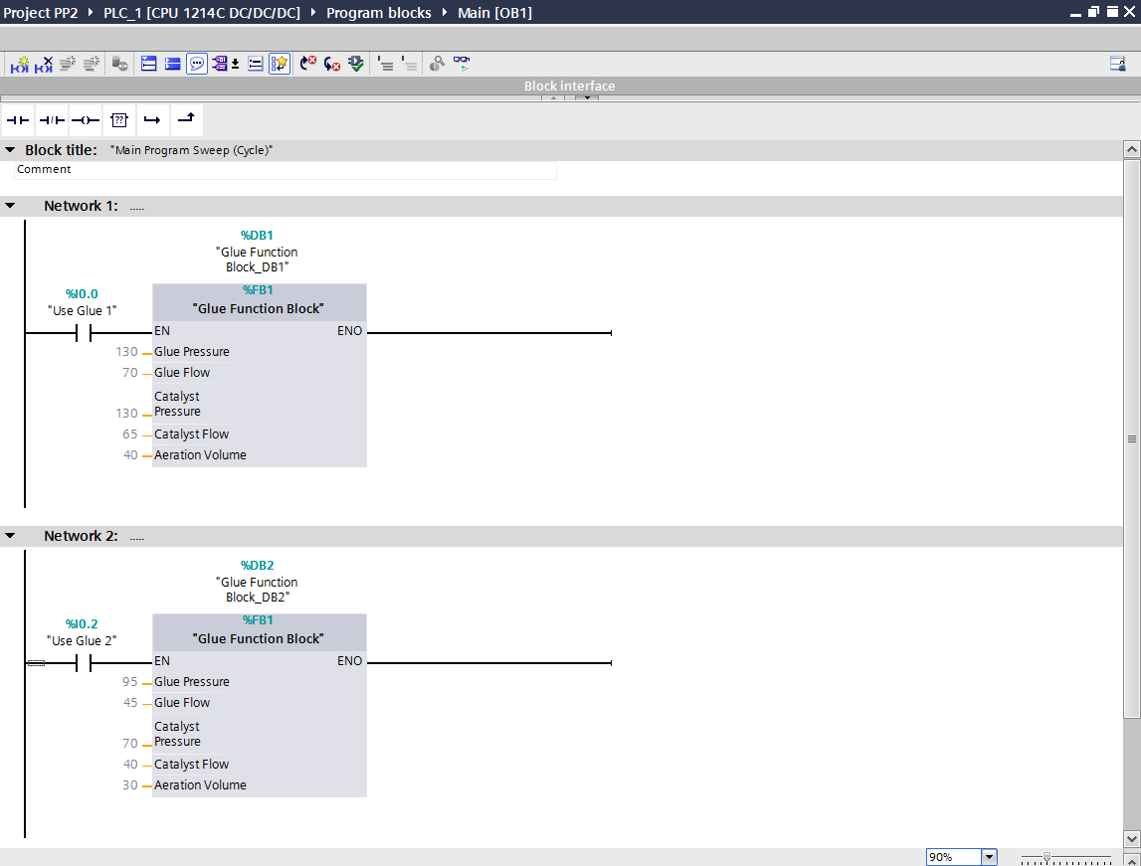
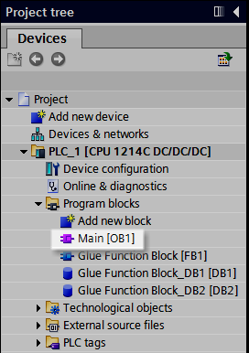

Function Block and Data Blocks
The Organization Block, Main program, calls to the Function Block.
Organization Block
Main [OB1]
When the Function Block is called to use Glue 2 type, the values stored in the Data Block Glue Function Block_DB2 [DB2] are used with the Instances.
When the Function Block is called to use Glue 1 type, the values stored in the Data Block Glue Function Block_DB1 [DB1] are used with the Instances.

